Slide 1

CSE 101 - COMPUTER PROGRAMMING I Mathematical Functions, Characters, and Strings
Joseph LEDET
Department of Computer Engineering
Akdeniz University
josephledet@akdeniz.edu.tr

Slide 2
Mathematical Functions
Java provides many useful methods in the Math class for performing common mathematical functions.

Slide 3
The Math Class
Class constants:
PI
E
Class methods:
Trigonometric Methods
Exponent Methods
Rounding Methods
min, max, abs, and random Methods

Slide 4
Trigonometric Methods
Examples:
Math.sin(0) returns 0.0
Math.sin(Math.PI / 6) returns 0.5
Math.sin(Math.PI / 2) returns 1.0
Math.cos(0) returns 1.0
Math.cos(Math.PI / 6) returns 0.866
Math.cos(Math.PI / 2) returns 0
sin(double a)
cos(double a)
tan(double a)
acos(double a)
asin(double a)
atan(double a)
Radians
toRadians(90)

Slide 5
Exponent Methods
Examples:
Math.exp(1) returns 2.71
Math.log(2.71) returns 1.0
Math.pow(2, 3) returns 8.0
Math.pow(3, 2) returns 9.0
Math.pow(3.5, 2.5) returns 22.91765
Math.sqrt(4) returns 2.0
Math.sqrt(10.5) returns 3.24
exp(double a)
Returns e raised to the power of a.
log(double a)
Returns the natural logarithm of a.
log10(double a)
Returns the 10-based logarithm of a.
pow(double a, double b)
Returns a raised to the power of b.
sqrt(double a)
Returns the square root of a.

Slide 6
Rounding Methods
double ceil(double x)
x rounded up to its nearest integer. This integer is returned as a double value.
double floor(double x)
x is rounded down to its nearest integer. This integer is returned as a double value.
double rint(double x)
x is rounded to its nearest integer. If x is equally close to two integers, the even one is returned as a double.
int round(float x)
Return (int)Math.floor(x+0.5).
long round(double x)
Return (long)Math.floor(x+0.5).

Slide 7
Rounding Methods Examples
Math.ceil(2.1) returns 3.0
Math.ceil(2.0) returns 2.0
Math.ceil(-2.0) returns –2.0
Math.ceil(-2.1) returns -2.0
Math.floor(2.1) returns 2.0
Math.floor(2.0) returns 2.0
Math.floor(-2.0) returns –2.0
Math.floor(-2.1) returns -3.0
Math.rint(2.1) returns 2.0
Math.rint(2.0) returns 2.0
Math.rint(-2.0) returns –2.0
Math.rint(-2.1) returns -2.0
Math.rint(2.5) returns 2.0
Math.rint(-2.5) returns -2.0
Math.round(2.6f) returns 3
Math.round(2.0) returns 2
Math.round(-2.0f) returns -2
Math.round(-2.6) returns -3

Slide 8
min, max, and abs
Examples:
Math.max(2, 3) returns 3
Math.max(2.5, 3) returns 3.0
Math.min(2.5, 3.6) returns 2.5
Math.abs(-2) returns 2
Math.abs(-2.1) returns 2.1
max(a, b)and min(a, b)
Returns the maximum or minimum of two parameters.
abs(a)
Returns the absolute value of the parameter.
random()
Returns a random double value in the range [0.0, 1.0).

Slide 9
The random Method
Generates a random double value greater than or equal to 0.0 and less than 1.0 (0 <= Math.random() < 1.0).
Examples:
In general,

Slide 10
Case Study: Computing Angles of a Triangle
Write a program that prompts the user to enter the x- and y-coordinates of the three corner points in a triangle and then displays the triangle’s angles.
IMPORTANT NOTE: If you cannot run the buttons, see www.cs.armstrong.edu/liang/javaslidenote.doc.
ComputeAngles
Run

Slide 11
Character Data Type
Four hexadecimal digits.
char letter = 'A'; (ASCII)
char numChar = '4'; (ASCII)
char letter = '\u0041'; (Unicode)
char numChar = '\u0034'; (Unicode)
NOTE: The increment and decrement operators can also be used on char variables to get the next or preceding Unicode character. For example, the following statements display character b.
char ch = 'a';
System.out.println(++ch);

Slide 12
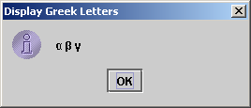
Unicode Format
Java characters use Unicode, a 16-bit encoding scheme established by the Unicode Consortium to support the interchange, processing, and display of written texts in the world’s diverse languages. Unicode takes two bytes, preceded by \u, expressed in four hexadecimal numbers that run from '\u0000' to '\uFFFF'. So, Unicode can represent 65535 + 1 characters.
Unicode \u03b1 \u03b2 \u03b3 for three Greek letters

Slide 13
ASCII Code for Commonly Used Characters

Slide 14
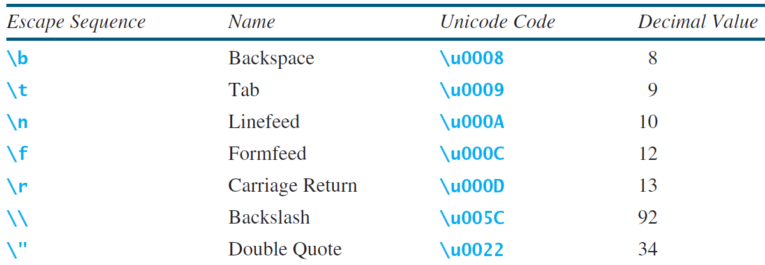
Escape Sequences for Special Characters

Slide 15
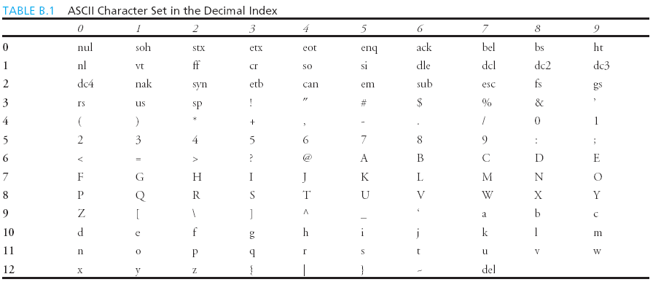
Appendix B: ASCII Character Set
ASCII Character Set is a subset of the Unicode from \u0000 to \u007f

Slide 16
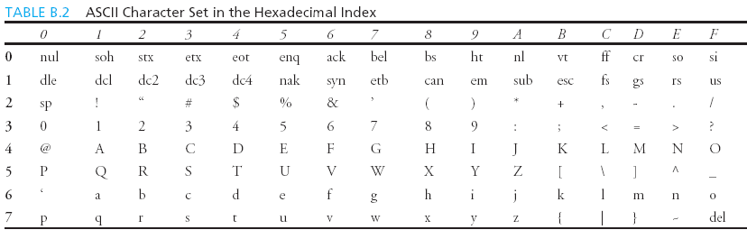
ASCII Character Set, cont.
ASCII Character Set is a subset of the Unicode from \u0000 to \u007f

Slide 17
Casting between char and Numeric Types
int i = 'a'; // Same as int i = (int)'a';
char c = 97; // Same as char c = (char)97;

Slide 18
Comparing and Testing Characters
if (ch >= 'A' && ch <= 'Z')
System.out.println(ch + " is an uppercase letter");
else if (ch >= 'a' && ch <= 'z')
System.out.println(ch + " is a lowercase letter");
else if (ch >= '0' && ch <= '9')
System.out.println(ch + " is a numeric character");

Slide 19
Methods in the Character Class

Slide 20
The String Type
The char type only represents one character. To represent a string of characters, use the data type called String. For example,
String message = "Welcome to Java";
String is actually a predefined class in the Java library just like the System class and Scanner class. The String type is not a primitive type. It is known as a reference type. Any Java class can be used as a reference type for a variable. Reference data types will be thoroughly discussed in Chapter 9, “Objects and Classes.” For the time being, you just need to know how to declare a String variable, how to assign a string to the variable, how to concatenate strings, and to perform simple operations for strings.

Slide 21
Simple Methods for String Objects

Slide 22
Simple Methods for String Objects
Strings are objects in Java. The methods in the preceding table can only be invoked from a specific string instance. For this reason, these methods are called instance methods. A non-instance method is called a static method. A static method can be invoked without using an object. All the methods defined in the Math class are static methods. They are not tied to a specific object instance. The syntax to invoke an instance method is
referenceVariable.methodName(arguments).

Slide 23
Getting String Length
String message = "Welcome to Java";
System.out.println("The length of " + message + " is "
+ message.length());

Slide 24
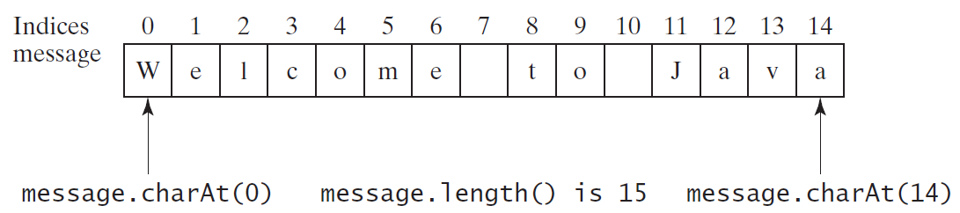
Getting Characters from a String
String message = "Welcome to Java";
System.out.println("The first character in message is "
+ message.charAt(0));

Slide 25
Converting Strings
"Welcome".toLowerCase() returns a new string, welcome.
"Welcome".toUpperCase() returns a new string, WELCOME.
" Welcome ".trim() returns a new string, Welcome.

Slide 26
String Concatenation
String s3 = s1.concat(s2); or String s3 = s1 + s2;
// Three strings are concatenated
String message = "Welcome " + "to " + "Java";
// String Chapter is concatenated with number 2
String s = "Chapter" + 2; // s becomes Chapter2
// String Supplement is concatenated with character B
String s1 = "Supplement" + 'B'; // s1 becomes SupplementB

Slide 27
Reading a String from the Console
Scanner input = new Scanner(System.in);
System.out.print("Enter three words separated by spaces: ");
String s1 = input.next();
String s2 = input.next();
String s3 = input.next();
System.out.println("s1 is " + s1);
System.out.println("s2 is " + s2);
System.out.println("s3 is " + s3);

Slide 28
Reading a Character from the Console
Scanner input = new Scanner(System.in);
System.out.print("Enter a character: ");
String s = input.nextLine();
char ch = s.charAt(0);
System.out.println("The character entered is " + ch);

Slide 29
Comparing Strings
OrderTwoCities
Run

Slide 30
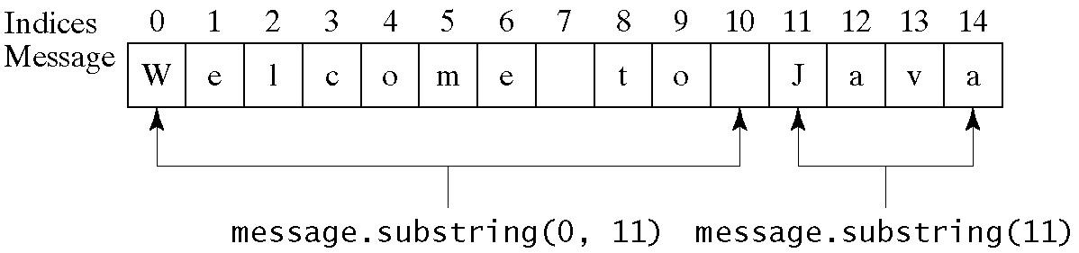
Obtaining Substrings

Slide 31
Finding a Character or a Substring in a String

Slide 32
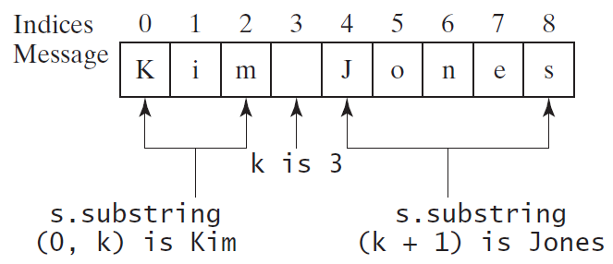
Finding a Character or a Substring in a String
int k = s.indexOf(' ');
String firstName = s.substring(0, k);
String lastName = s.substring(k + 1);

Slide 33
Conversion between Strings and Numbers
int intValue = Integer.parseInt(intString);
double doubleValue = Double.parseDouble(doubleString);
String s = number + "";

Slide 34
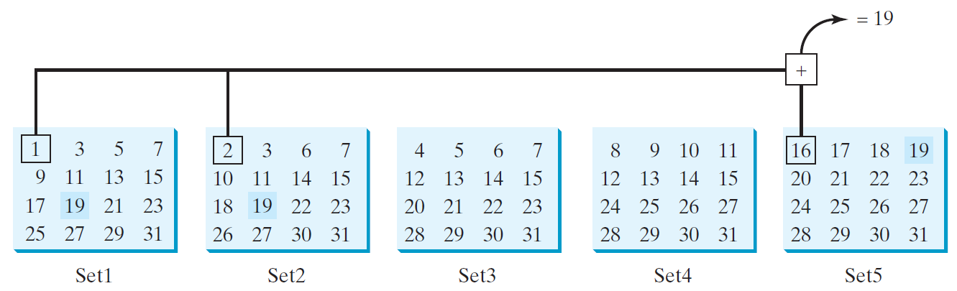
Problem: Guessing Birthday
The program can guess your birth date. Run to see how it works.
GuessBirthday

Slide 35
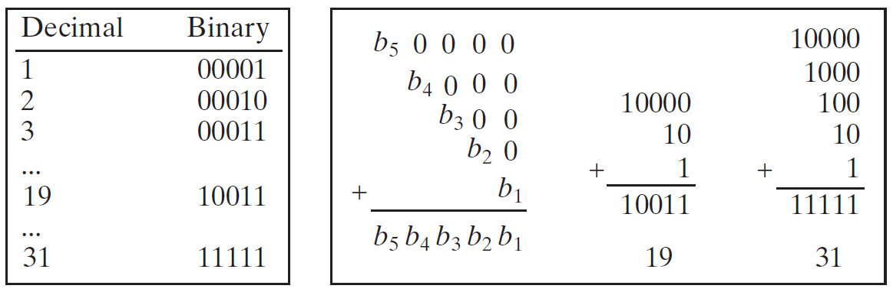
Mathematics Basis for the Game
19 is 10011 in binary. 7 is 111 in binary. 23 is 11101 in binary

Slide 36
Case Study: Converting a Hexadecimal Digit to a Decimal Value
Write a program that converts a hexadecimal digit into a decimal value.
HexDigit2Dec
Run

Slide 37
Case Study: Revising the Lottery Program Using Strings
A problem can be solved using many different approaches. This section rewrites the lottery program in Listing 3.7 using strings. Using strings simplifies this program.
LotteryUsingStrings
Run

Slide 38
Formatting Output
Use the printf statement.
System.out.printf(format, items);
Where format is a string that may consist of substrings and format specifiers. A format specifier specifies how an item should be displayed. An item may be a numeric value, character, boolean value, or a string. Each specifier begins with a percent sign.

Slide 39
Frequently-Used Specifiers
Specifier Output Example
%b a boolean value true or false
%c a character 'a'
%d a decimal integer 200
%f a floating-point number 45.460000
%e a number in standard scientific notation 4.556000e+01
%s a string "Java is cool"

Slide 40
FormatDemo
The example gives a program that uses printf to display a table.
FormatDemo
Run

